Slide 1
Are You Paying Attention?
Driver Distraction Detection
A comparative study on various machine learning and deep learning techniques for the classification problem of driver distraction.

Slide 2
Introduction
We've all been there: a light turns green and the car in front of you doesn't budge. Or, a previously unremarkable vehicle suddenly slows and starts swerving from side-to-side.
When you pass the offending driver, what do you expect to see? You certainly aren't surprised when you spot a driver who is texting, seemingly enraptured by social media, or in a lively hand-held conversation on their phone.
According to the CDC motor vehicle safety division, one in five car accidents is caused by a distracted driver. Sadly, this translates to 425,000 people injured and 3,000 people killed by distracted driving every year.
The idea hopes to improve these alarming statistics, and better insure their customers, by testing whether dashboard cameras can automatically detect drivers engaging in distracted behaviors.

Slide 3
Having introduced the idea, we now proceed with the detailed implementation of the project, which has been divided into the following phases:
Data Understanding- A brief description about the dataset, source, etc.
Data Preprocessing/Analysis- Preprocessing and extracting features from the data.
Modelling- A comparative study on the various machine learning and deep learning approaches used.
Evaluation- Assessing the performance of the model based on various classification accuracy metrics
Further, possible deployment strategies and applications have been discussed.

Slide 4
Data Understanding

Slide 5
The data set we have used for our project has been taken from a Kaggle Challenge for Distracted Driver Detection by State Farm.
In this competition, we are given driver images, each taken in a car with a driver doing something in the car (texting, eating, talking on the phone, makeup, reaching behind, etc). The goal of this computer vision is to predict the likelihood of what the driver is doing in each picture.
The 10 classes predicted are:
c0 | Safe Driving | c5 | Operating Radio
c1 | Texting-Right | c6 | Drinking
c2 | Talking On Phone - Right | c7 | Reaching Behind
c3 | Texting-Left | c8 | Hair and Makeup
c4 | Talking On Phone -Left | c9 | Talking to Passenger

Slide 6
The dataset has a set of labelled images for training, and a set of unlabeled images for testing and submitting.
For our project, we have used only the training dataset of labeled images for both training our models and evaluating them.
The training set was balanced with around 2200 images for all the 10 target classes. Thus, the distribution of the target class was symmetric. (not skewed)
The total number of labelled images was 22,414.
All the images were of the same size – 480x480 pixels. But in order to reduce the number of pixels, they were resized to 100x100 pixels.
Some images from the dataset have been shown here:

Slide 7
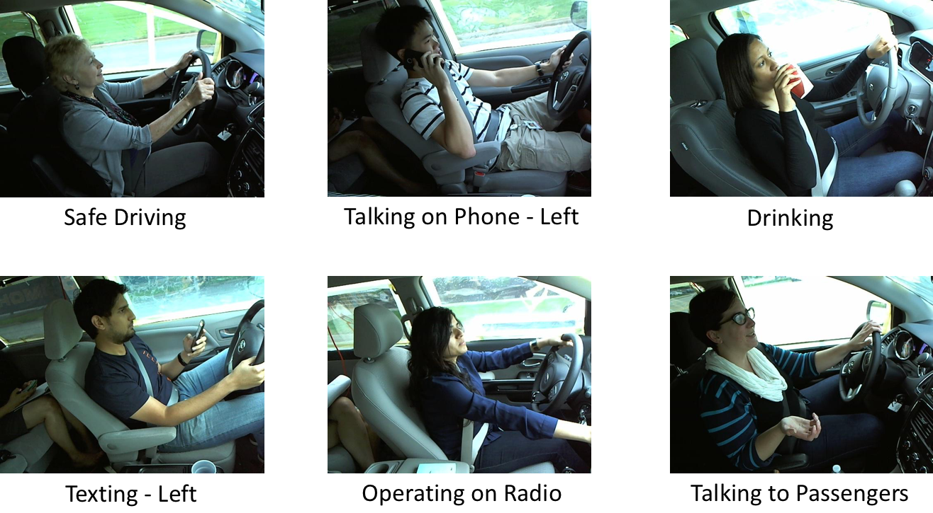

Slide 8
Data Preprocessing

Slide 9
Considering the task on hand, we intuitively thought that not all the pixel values contributed equal weights to the class value assigned to a particular image.
Consider the two images below:
We can clearly see that it is mostly the positioning of the hands of the driver that contributes the most to the classification. In some cases, say if the driver is talking to the passenger or is reaching behind, the position of the face may also be useful.

Slide 10
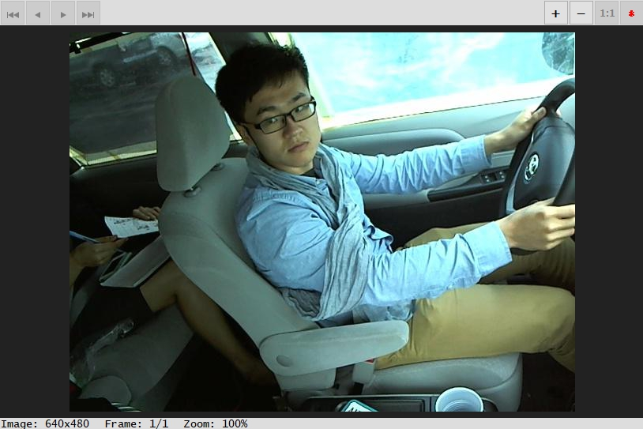
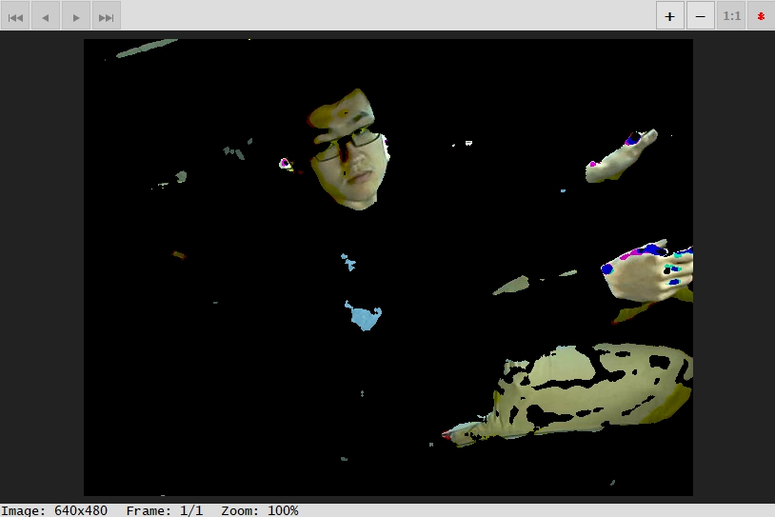
On these grounds, we found it safe to preprocess the images to remove the background noise which barely contributed as a prominent feature.
We wrote an R script to reduce all the background pixels to black by using filters.
We found a list of possible skin colors and then used the dplyr and EBImage R libraries to create filters for the same. This was followed by some smoothening to make the adjacent pixel intensities similar.
Sample preprocessing:

Slide 11
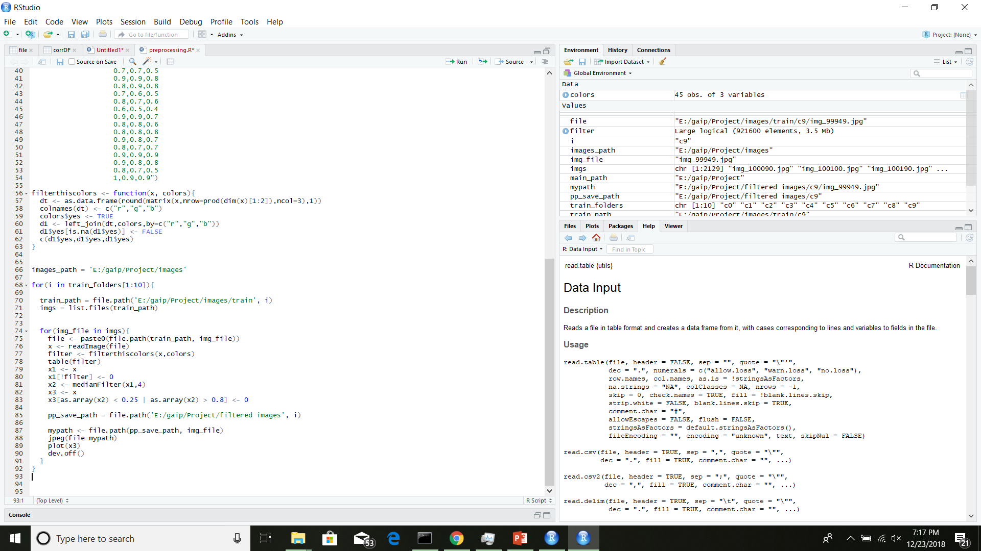
R Script:

Slide 12
Feature Extraction

Slide 13
Having done some preprocessing by removing the noisy background pixels, we did some feature extraction. Our images till now were encoded as 30,000 (100x100x3) pixel values. We could feed these values directly to the model, but training these models would have taken a lot of time as the number of dimensions is too large.
We thus performed feature extraction. For this we used Convolutional layers, which are widely used for extracting features out of the images.
Our convolutional network for feature extraction is the VGG16 model that is pre-trained on the ImageNet Dataset. We feed-forward our images through this network to get the features.
This extraction reduced our dimension to 4,068 which is a huge drop from a previous of 30,000 dimensions.

Slide 14
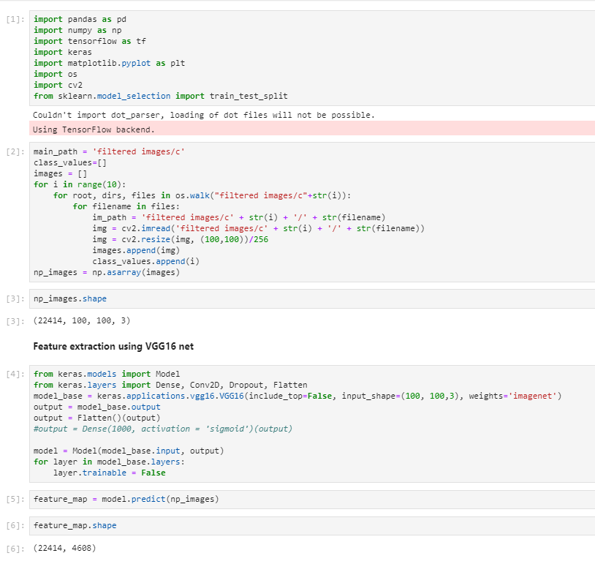
Python Script

Slide 15
Modelling

Slide 16
We have performed a comparative analysis on various modelling techniques, including machine learning and deep learning architectures to find the best model for the problem. The models we have used are as follows: (in order of increasing complexity)
K-Nearest Neighbor Classifier
Support Vector Classifier
Decision Tree
CNN (transfer learning on VGG16)
LSTM
Each of these techniques has been discussed in detail below:

Slide 17
LSTM
Although LSTMs are mainly used for time series and sequence data, the architecture seemed to perform unbelievably well on the image classification problem at hand.
For this model, we took raw preprocessed images.
For passing the data to the model, we reshaped our images in sequence form. We took each 100x100 images, and reshapes it to (100, 100, 1) so that we had 100 sequences of the shape (100, 1).
The intuition can be thought of as this way: Since when an image loads, it loads from top to bottom; first the top row pixels load, then next row and so on.
The LSTM model gets 1 row of pixels as input at a time, which it remembers using its hidden cells until it has seen all the pixel rows, after which it makes classification prediction.
The model performs really well and takes comparatively very less time for training.
Each epoch took ~1min with around 15000 data points, which is very less as compared to the large training time of VGG16 because of its deep structure.

Slide 18
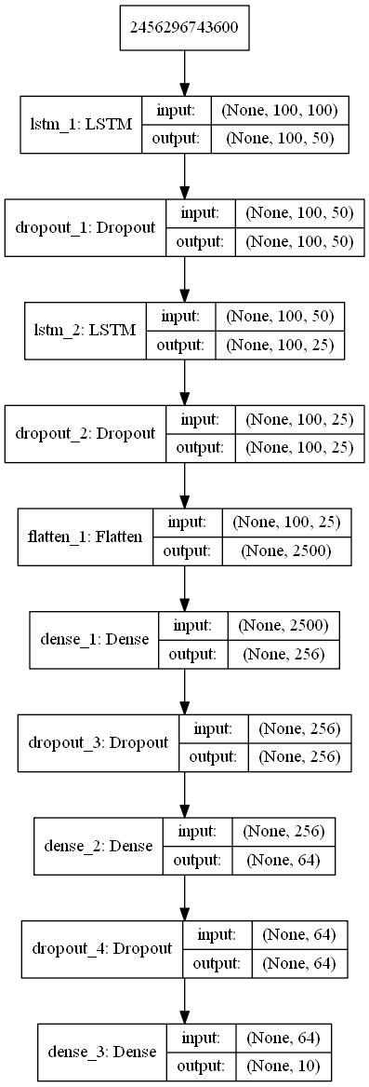
LSTM Architecture
The architecture used had 2 LSTM layers with 50 and 25 neurons respectively.
Dropout layers are added as a measure to avoid overfitting, to meet the overall goal of generalization.
The LSTM layers are followed by the fully connected layers. All the Dense layers use ReLU as the non linear function, except for the last layer which uses the softmax non linearity to produce the final classification output.

Slide 19
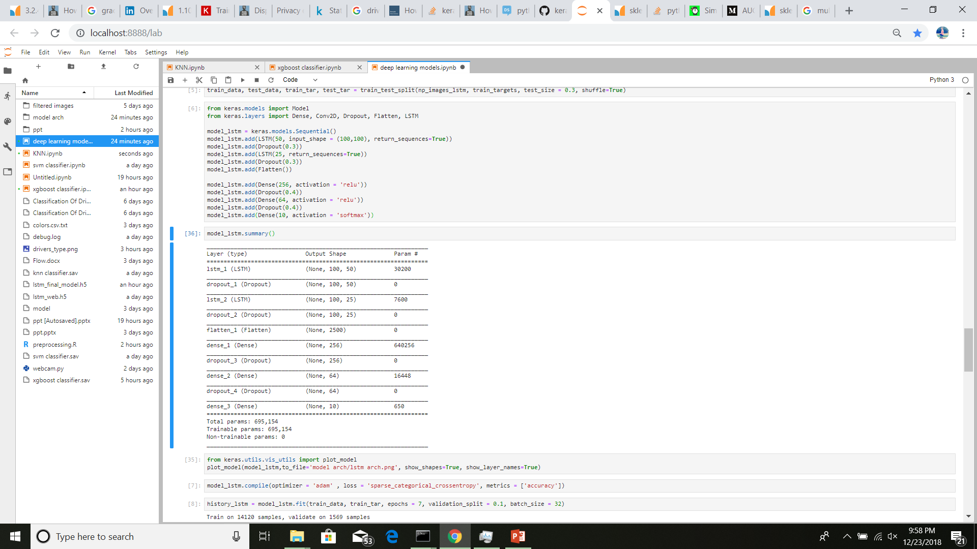
LSTM Model Training
We split the data into train and test sets, with a test split of 30%.
The loss function minimized is the cross-entropy loss function.
The optimizer used Adam Optimizer, which is an improved version of Vanilla Gradient Descent algorithm, with added variations to overcome the affect of local minima.
While training, we look at the accuracy as a performance metric.
Also, we used 10% of our training set as validation set to see the generalized performance at the end of each epoch.
A batch size of 32 is used in our model.

Slide 20
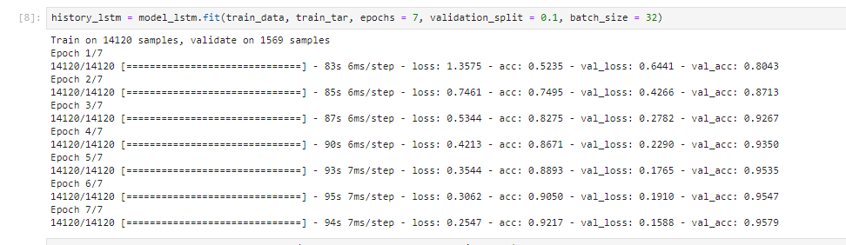
LSTM Model Training (contd.)
We trained the model for 7 epochs.
The both the training and validation accuracy improved drastically.
Initial training accuracy: 0.5235
Final training accuracy: 0.9217

Slide 21
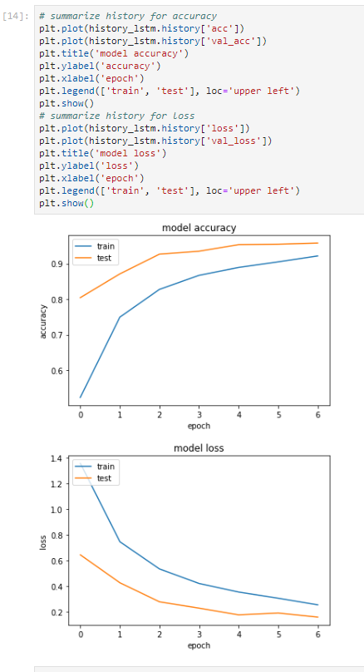
LSTM Model Training (contd.)
The plots show the variation of accuracy and the loss function with each epoch for the training and the validation set.
The plots clearly show that the model performs very well on the validation set and thus has a higher generalization (test) accuracy and lower generalization loss . This is exactly what we want.

